Slide 1

Algebra 1
Unit 5, Lesson 4 Writing and Solving Real-World Equations Volume 1, pg. 244

Slide 2


Benchmark
MA.912.AR.2.1
Given a real-world context, write and solve one-variable multi-step linear equations.
volume 1, pg. 244

Slide 3
Integrated Mathematical Thinking and Reasoning Standards
MA.K12.MTR.1.1 Actively participate in effortful learning both individually and collectively.
MA.K12.MTR.4.1 Engage in discussions that reflect on the mathematical thinking of self and others.
MA.K12.MTR.6.1 Assess the reasonableness of solutions.
MA.K12.MTR.7.1 Apply mathematics to real-world contexts.
volume 1, pg. 244

Slide 4

Learning Target
I can write and solve two-step equations given a real-world context.
volume 1, pg. 244

Slide 5

Warm-Up
volume 1, pg. 244

Slide 6
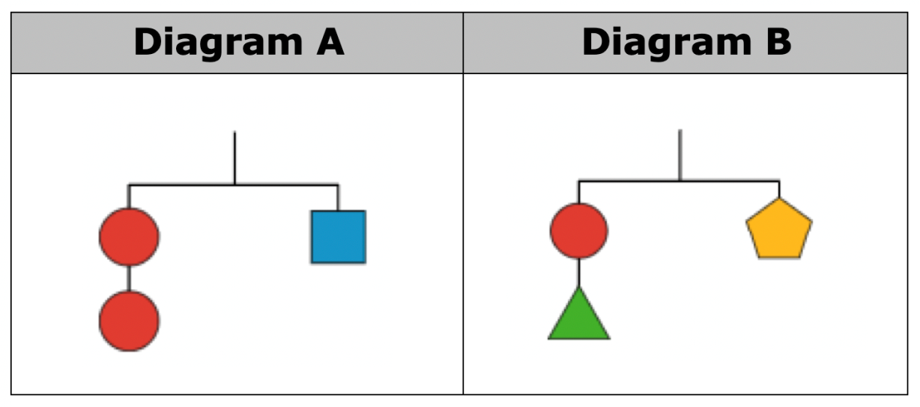
5.4.1 Warm-Up: Hanger Diagrams
Two hanger diagrams are shown. They are balanced with an equal weight hanging from both sides.
volume 1, pg. 244

Slide 7
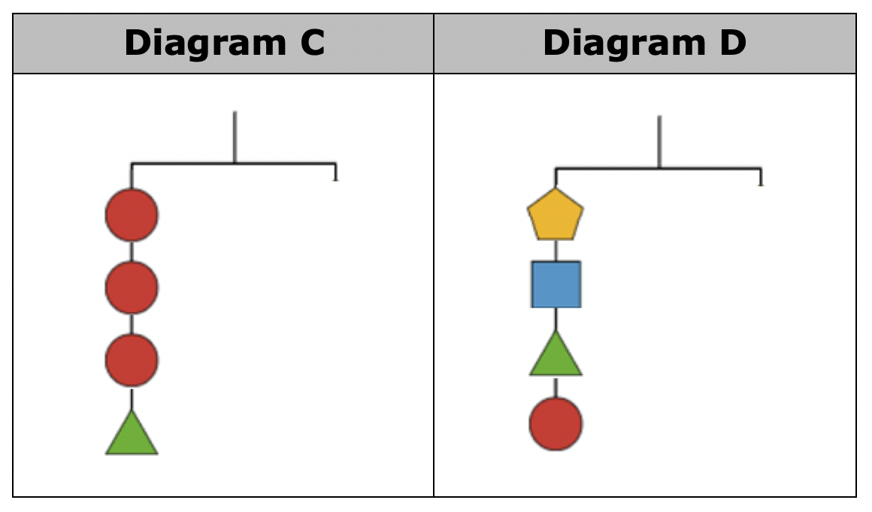
Use the diagrams above to complete the right side of each diagram so that Diagrams C and D are balanced. You cannot copy the left side of the diagram.
volume 1, pg. 244

Slide 8
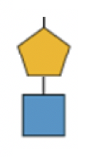
James drew a pentagon and a square for the right side of Diagram C. Draw pictures or explain how James could conclude that a pentagon and a square are equivalent to the left side of Diagram C.
volume 1, pg. 245

Slide 9

Guided Instruction
volume 1, pg. 245

Slide 10
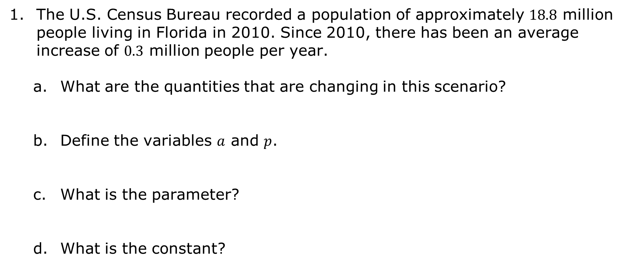
5.4.2 Guided Instruction: Solving Real-World Problems by Writing and Solving Equations
The U.S. Census Bureau recorded a population of approximately $18.8$ million people living in Florida in 2010. Since 2010, there has been an average increase of $0.3$ million people per year.
What are the quantities that are changing in this scenario?
Define the variables $a$ and $p$.
What is the parameter?
What is the constant?
volume 1, pg. 245

Slide 11
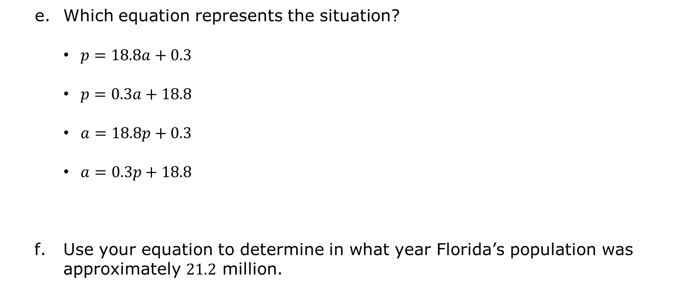
Which equation represents the situation?
$p=18.8a+0.3$
$p=0.3a+18.8$
$a=18.8p+0.3$
$a=0.3p+18.8$
Use your equation to determine in what year Florida’s population was approximately $21.2$ million.
volume 1, pg. 245

Slide 12
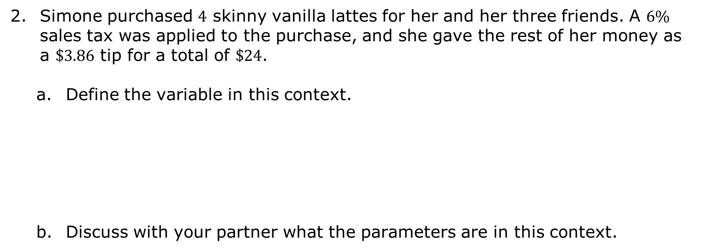
Simone purchased $4$ skinny vanilla lattes for her and her three friends. A $6\%$ sales tax was applied to the purchase, and she gave the rest of her money as a $\$3.86$ tip for a total of $\$24$.
Define the variable in this context.
Discuss with your partner what the parameters are in this context.
volume 1, pg. 246

Slide 13
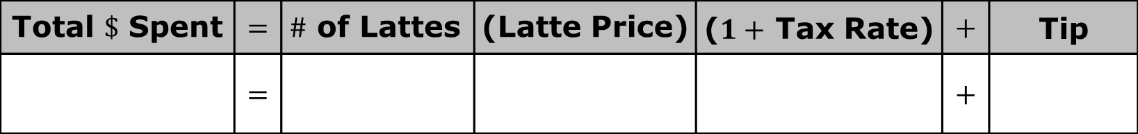
Complete the table to write an equation that represents the context.
Solve the equation for the unknown.
Interpret the solution.
Total $\$$ Spent | $$=$$ | $\#$ of Lattes | (Latte Price) | ($1+$ Tax Rate) | $$+$$ | Tip
 | $$=$$ |  |  |  | $$+$$
volume 1, pg. 246

Slide 14

Guided Practice
volume 1, pg. 246

Slide 15

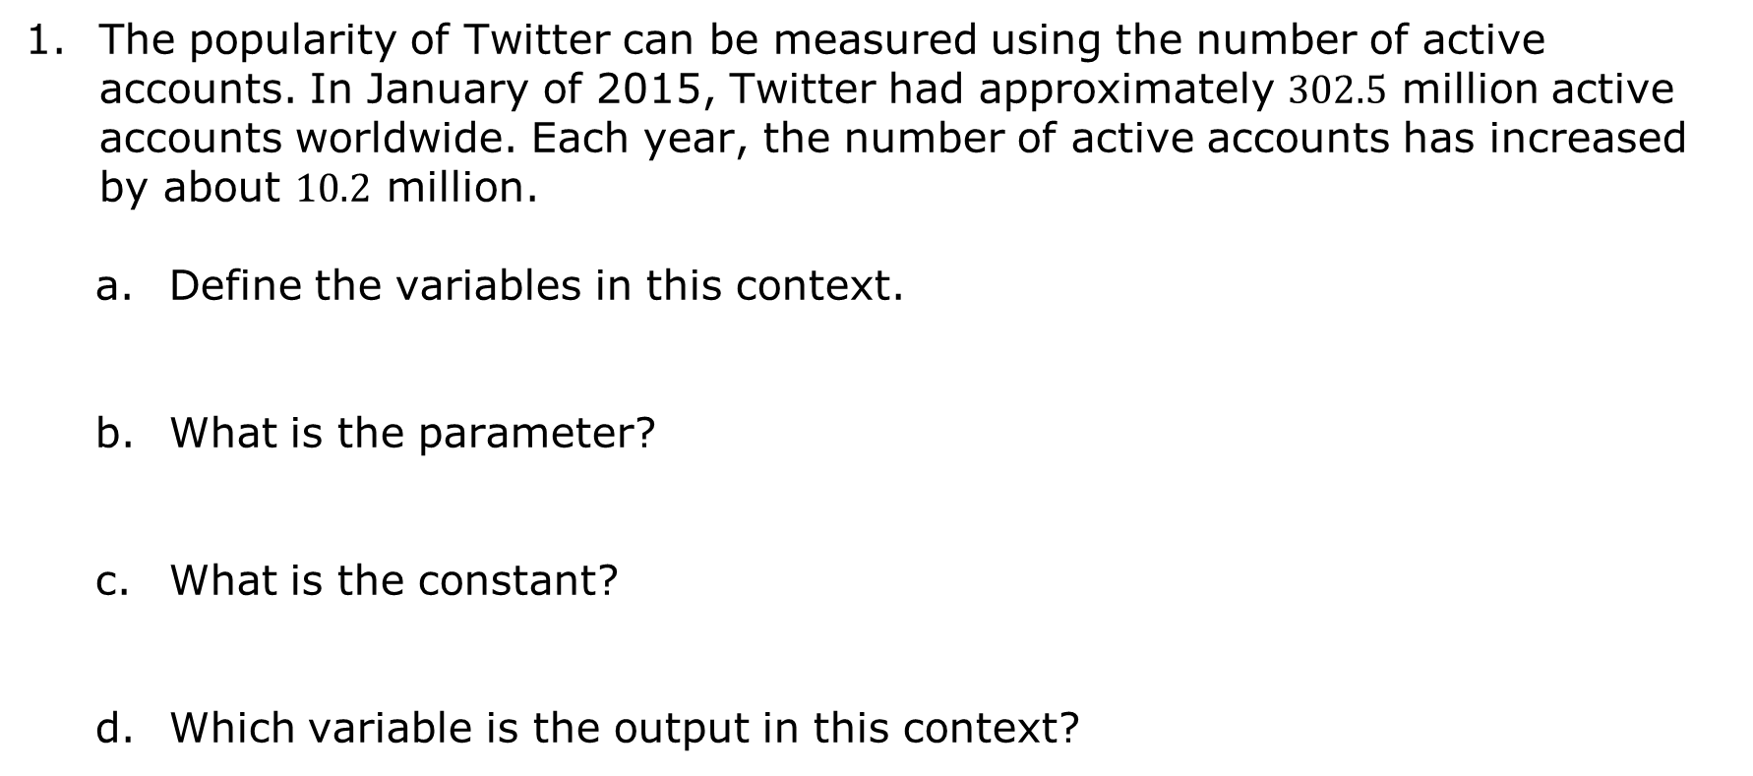
5.4.3 Guided Practice: Solving Real-World Problems by Writing and Solving Equations
The popularity of Twitter can be measured using the number of active accounts. In January of 2015, Twitter had approximately $302.5$ million active accounts worldwide. Each year, the number of active accounts has increased by about $10.2$ million.
Define the variables in this context.
What is the parameter?
What is the constant?
Which variable is the output in this context?
volume 1, pg. 246

Slide 16
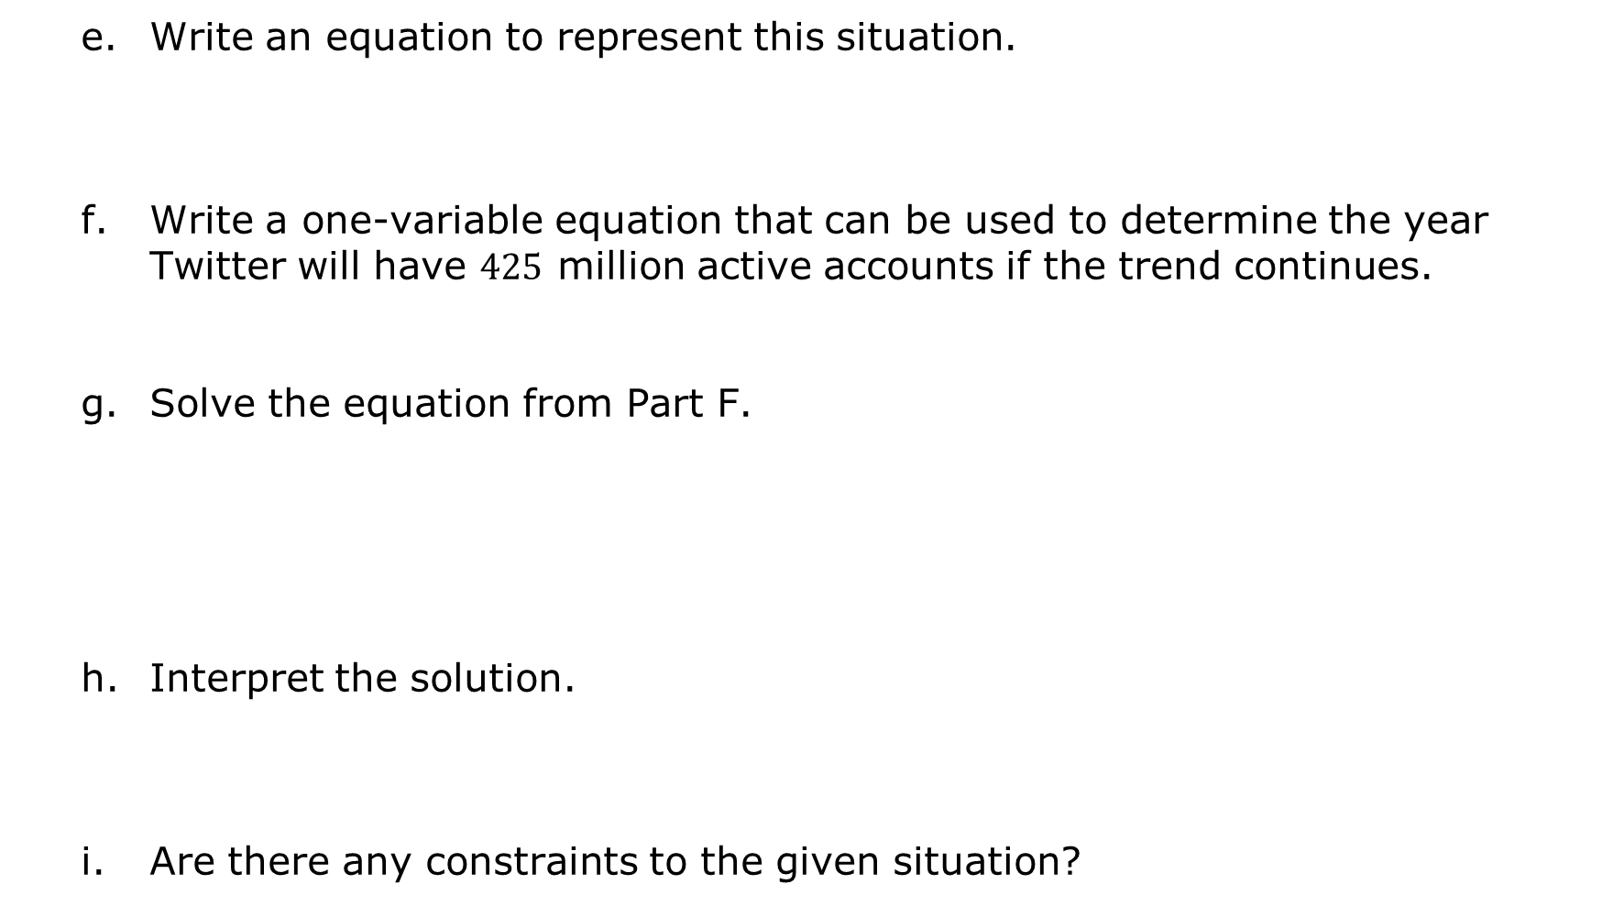
Write an equation to represent this situation.
Write a one-variable equation that can be used to determine the year Twitter will have $425$ million active accounts if the trend continues.
Solve the equation from Part F.
Interpret the solution.
Are there any constraints to the given situation?
volume 1, pg. 247

Slide 17

Try It
volume 1, pg. 247

Slide 18

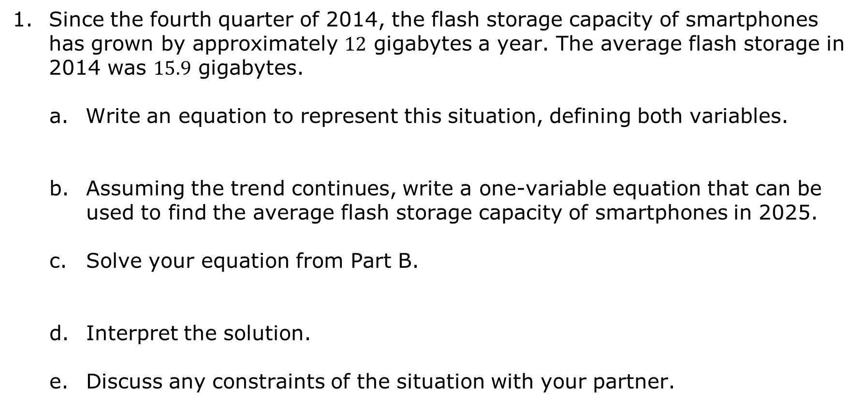
5.4.4 Try It: Solving Real-World Problems by Writing and Solving Equations
Since the fourth quarter of 2014, the flash storage capacity of smartphones has grown by approximately $12$ gigabytes a year. The average flash storage in 2014 was $15.9$ gigabytes.
Write an equation to represent this situation, defining both variables.
Assuming the trend continues, write a one-variable equation that can be used to find the average flash storage capacity of smartphones in 2025.
Solve your equation from Part B.
Interpret the solution.
Discuss any constraints of the situation with your partner.
volume 1, pg. 247

Slide 19

Wrap-Up
volume 1, pg. 248

Slide 20
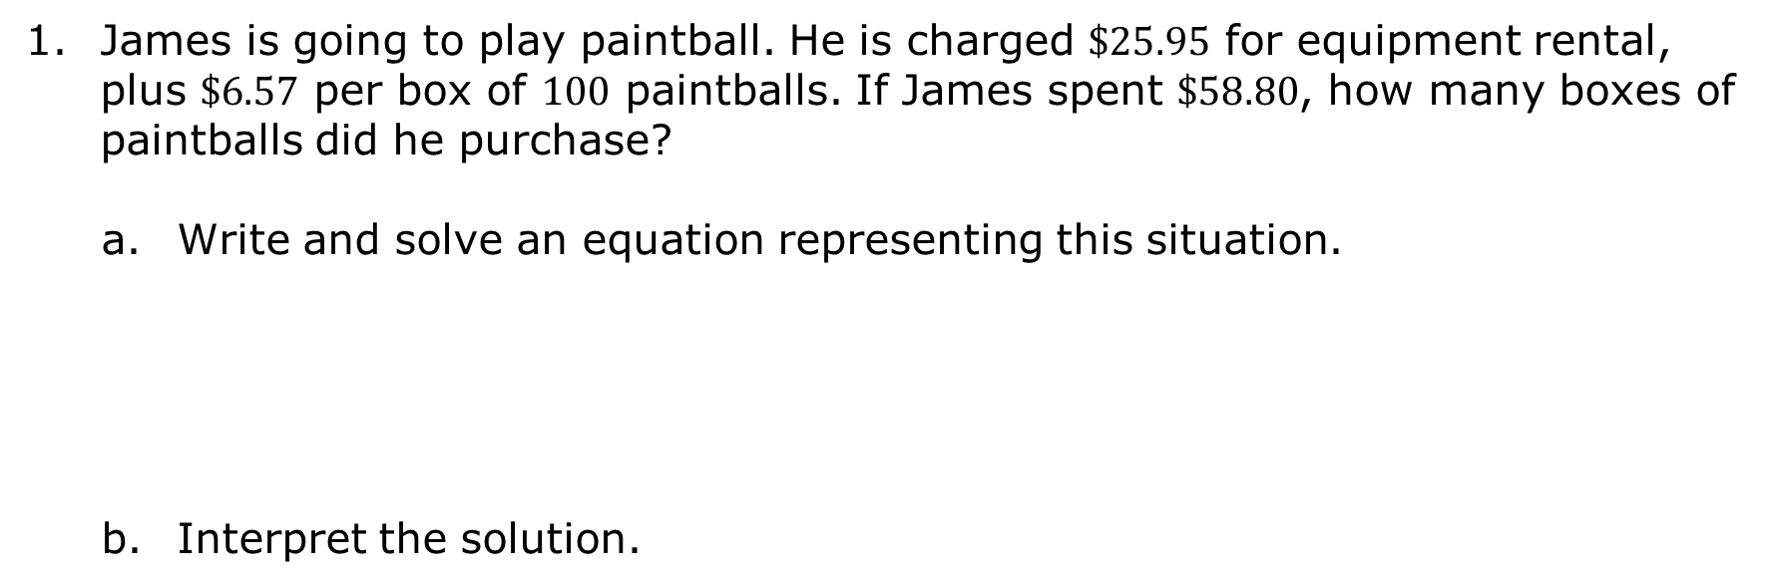
5.4.5 Wrap-Up: Ticket Out the Door
James is going to play paintball. He is charged $\$25.95$ for equipment rental, plus $\$6.57$ per box of $100$ paintballs. If James spent $\$58.80$, how many boxes of paintballs did he purchase?
Write and solve an equation representing this situation.
Interpret the solution.
volume 1, pg. 248

